Slide 1
WikiLeaks, Julian Assange
Xinyue Song

Slide 2

What is WikiLeaks
WikiLeaks is an international non-profit organisation that publishes secret information, news leaks, and classified media provided by anonymous sources.
Website is founded in 2006 in Iceland.
It claims a database of 10 million documents in 10 years since its launch.
Staffs are all volunteers.
https://wikileaks.org/

Slide 3
Goal of WikiLeaks
According to its website:
“Our goal is to bring important news and information to the public.”
“One of our most important activities is to publish original source material alongside our news stories so readers and historians alike can see evidence of the truth.”

Slide 4
What is the difference
Anonymous Sources: Hackers, Insiders ect.
Play as a middleman not hacker.
Posts unfiltered classified documents.
No editorial hirackey.
Traditional media like New York Time
Information
Reporter
Editor
Publish
WikiLeaks

Slide 5
How does it work
Use online dropbox system created by Julian Assange allow provider submit sources anonymously.
Traffic can not be tracked.
No officially headquarters but have with the main server in Sweden.

Slide 6
Become famous in 2010
April 5, 2010 - A classified military video is posted by WikiLeaks. It shows a US Apache helicopter firing on and killing two journalists and a number of Iraqi civilians in 2007.
July 25, 2010 - WikiLeaks posts more than 90,000 classified documents relating to the Afghanistan war in what has been called the biggest leak since the Pentagon Papers during the Vietnam War.

Slide 7
Recents leaks
July 22, 2016 - WikiLeaks releases nearly 20,000 emails from Democratic National Committee staffers. The emails appear to show the committee favoring Hillary Clinton over Bernie Sanders during the US presidential primary.
March 7, 2017 - WikiLeaks claimed the CIA had built the software to exploit vulnerabilities in Samsung products which would allow them to turn any phone or smart TV into a listening device.
https://www.cnn.com/2013/06/03/world/wikileaks-fast-facts/index.html

Slide 8
Julian Assange
Born in Australia in 1971.
Being a hacker since 1987.
By 1991 he hacked The Pentagon, US Navy, NASA, US Department of Defense.
1996, arrested by Australian Federal Police in charge of 30 counts of hacking related crimes.
Attend University of Melbourne in 2003.
Found WikiLeaks in 2006.
Australian computer programer, Founder of WikiLeaks
Hero, Terrorist,

Slide 9
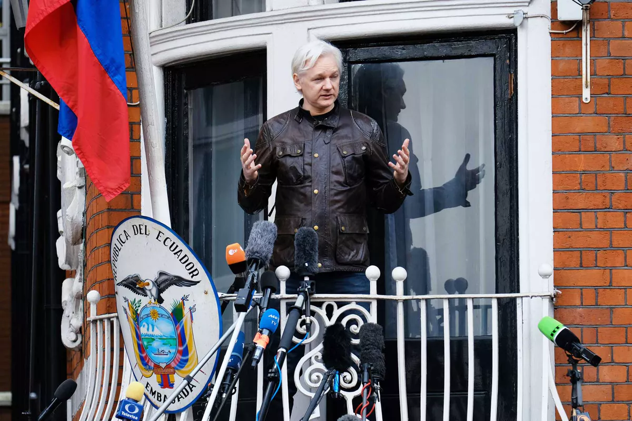
Timeline
November 20, 2010 - The Stockholm Criminal Court issues an arrest warrant for Assange.
December 7, 2010 - Turns himself in to London authorities. Assange is remanded in custody.
December 16, 2010 - Is released on bail and put on house arrest.
June 19, 2012 - Assange enters the Ecuadorian Embassy in London, requesting political asylum.
May 19, 2017 - Swedish prosecutors drop their investigation of rape allegations against Assange, ending a nearly seven-year legal impasse.

Slide 10
Sources
https://www.youtube.com/watch?v=9F6_7tFOH9k
https://www.youtube.com/watch?v=3IFpH3M24ik
https://www.technologyreview.com/s/421949/everything-you-need-to-know-about-wikileaks/

